Slide 1
Come
to
my
birthday !

Slide 2
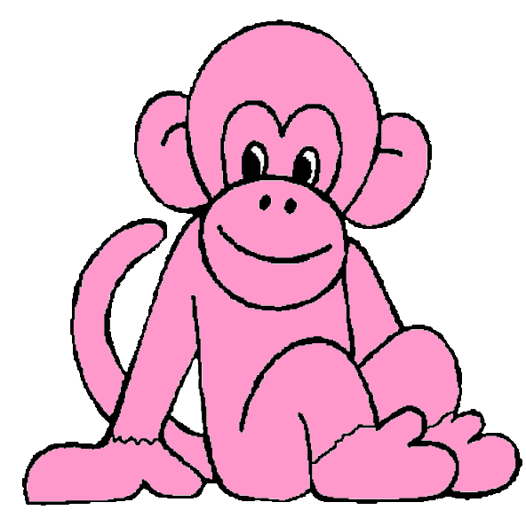
Hello !
I’m a pink monkey.
Today, it’s my
birthday !

Slide 3
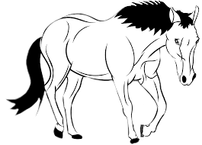
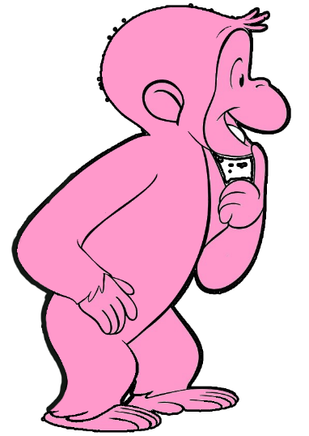
Hello, white horse,
come to my birhday !
Hello pink
monkey.
Ok, thank you !

Slide 4
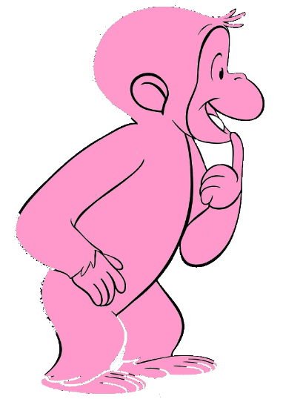
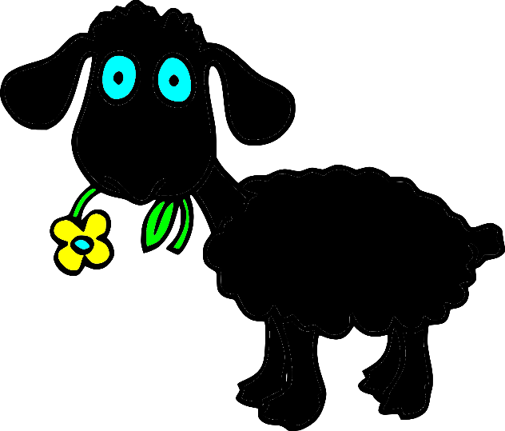

Slide 8
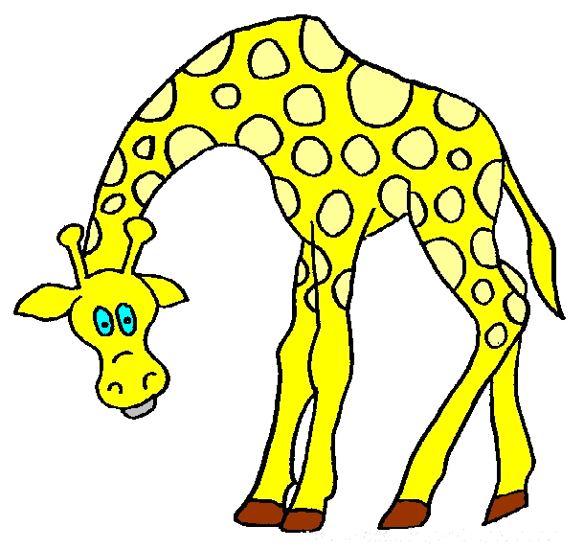

Slide 9
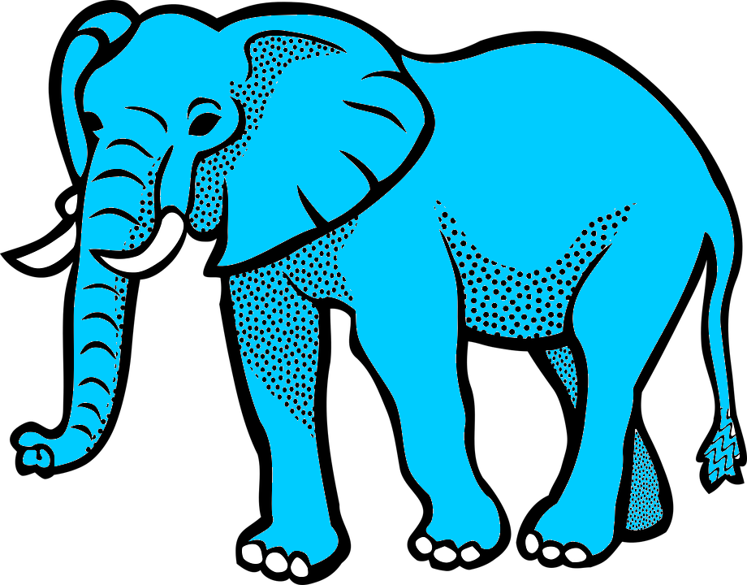

Slide 10
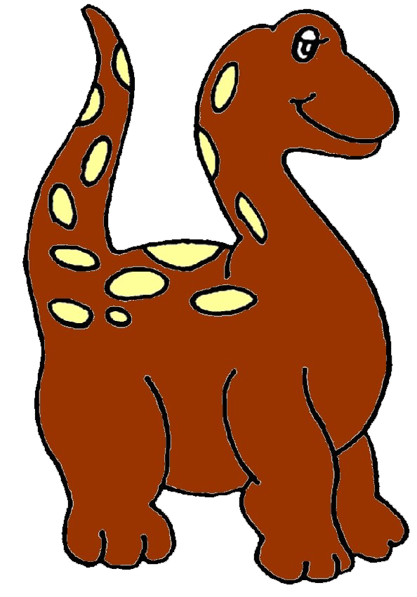

Slide 12
